Slide 1
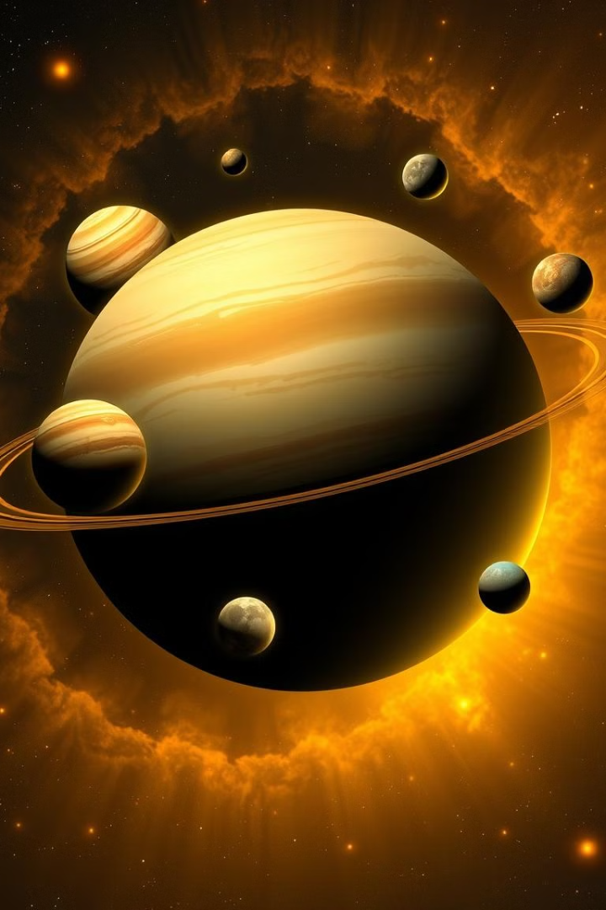
Exploring the Solar System with C
This presentation outlines a C & HTML- CSS-based approach to simulating the dynamics of our solar system, showcasing how programming can be used to model celestial objects and their interactions.
Presented By 😎 :
24CE055 - URVAL KHENI
24CE064 - HEET MEHTA
24CE071 - DHRUV PARMAR

Slide 2
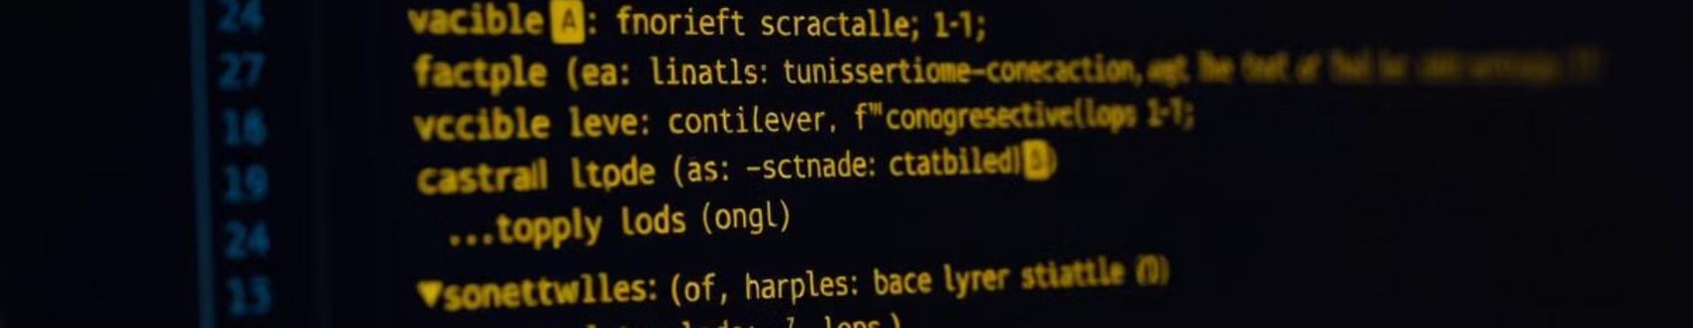
Objective To Choose This Project
1
1. To explore more about C
2
2. Combination of other languages
3
3. To create a user-friendly interface of solar system
As C Is a base language, by creating this project we have explored more about the C basics libraries and its header files.
C supports the logical part of the backend and HTML CSS supports the frontend of the project
In this project, the details of all the planets are given when we click on that planet.

Slide 3
Applicability In Real World
Educational Tool
Astronomy and Astrophysics Research
As solar system simulation written in C can be a valuable tool for educators and students to better understand gravitational forces, orbital motion, Kepler’s Laws, and Newton’s Laws of Motion. Students can adjust parameters and see how changing one element (like mass or velocity) affects the system, providing hands-on learning.
Simulating the movement of planets, moons, and other celestial bodies can help scientists model real-world planetary orbits, gravitational forces, and the dynamics of star systems. By adjusting the parameters (e.g., mass, velocity, distance), researchers can study the stability of orbits, gravitational interactions, and planetary system evolution.

Slide 4
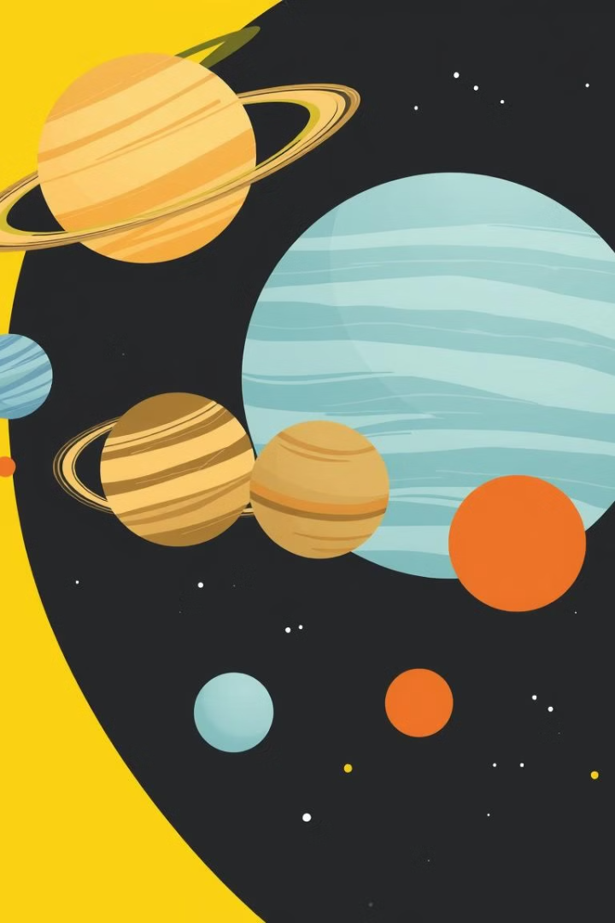
Representing the Planets
Planetary Data
Orbital Paths
Create structures or classes to store each planet's mass, radius, orbital distance, and other relevant information.
Use mathematical equations and data structures like arrays or linked lists to represent planetary orbits.

Slide 5
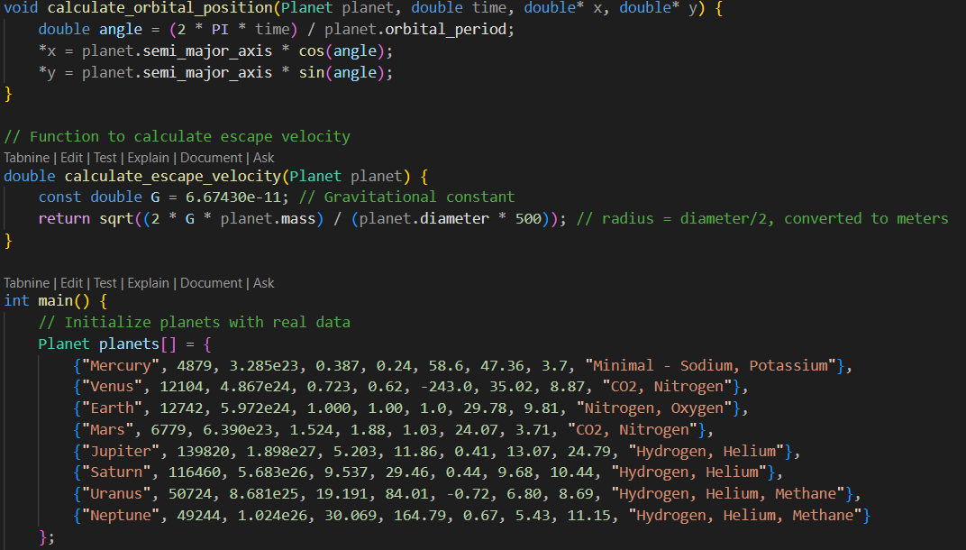
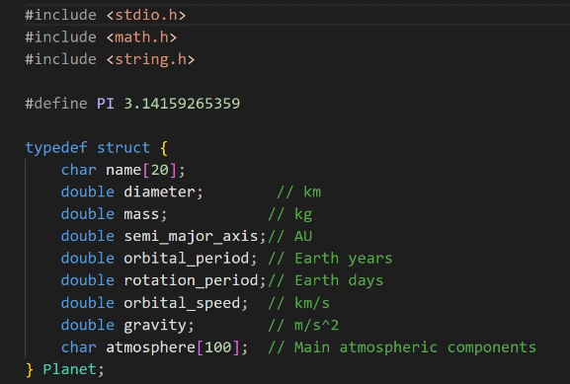
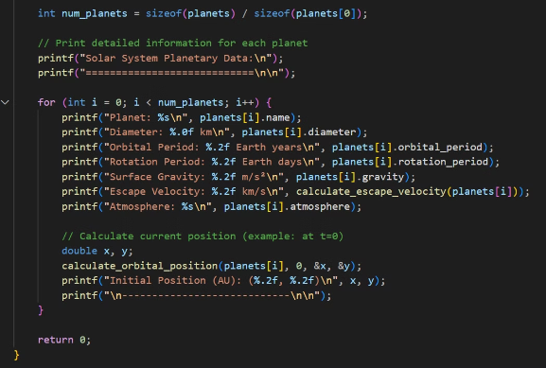
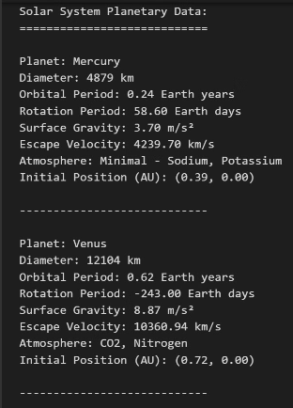
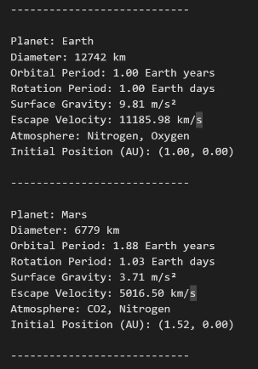
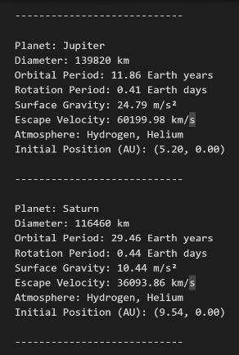
Code Of The Project
Logic
Declaration
Output
Display Data of Planets

Slide 6
VISUAL REPRESENTATION OF THE SOLAR SYSTEM

Slide 7
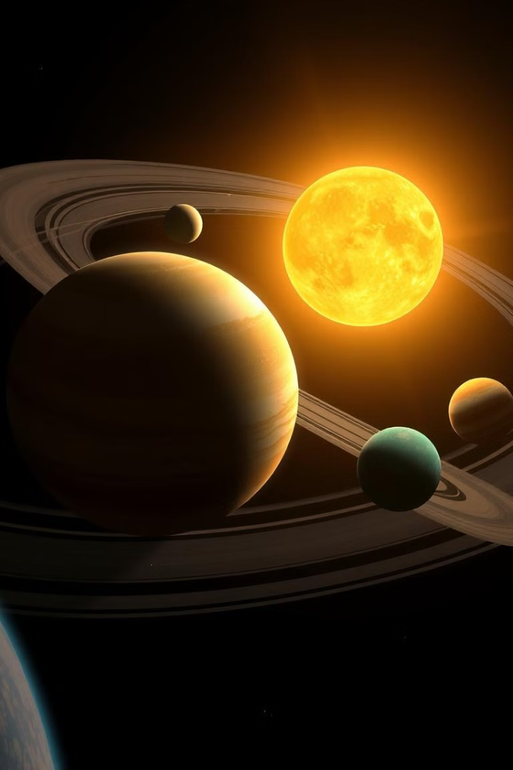
Simulating Celestial Motion
1
Rotation
Implement functions to calculate and update the rotation of each planet based on its rotation period.
2
Revolution
Use mathematical equations and time-based calculations to model the planets' revolutions around the sun.
3
Interaction
Implement logic to handle collisions, close encounters, and other interactions between celestial objects.

Slide 8
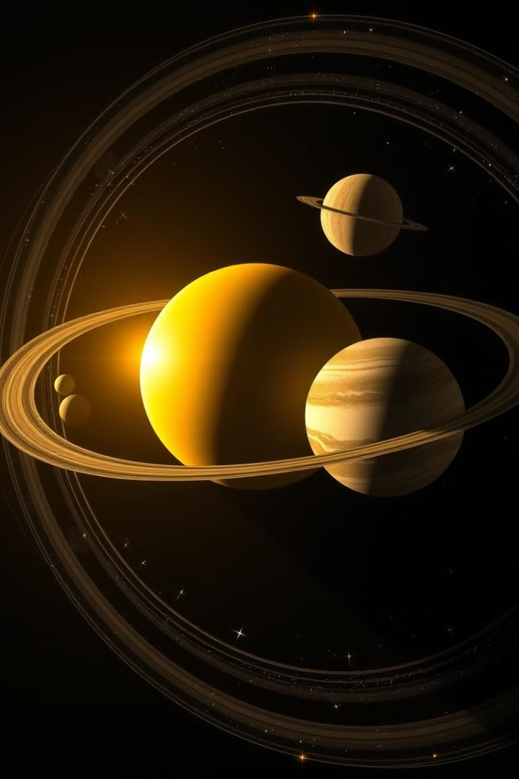


Visualizing Solar System Dynamics
Data Visualization
Animation
Visualize planetary trajectories, orbital paths, and other data using charts or graphs.
Create animations to dynamically showcase the motion and interactions of the celestial bodies.

Slide 9
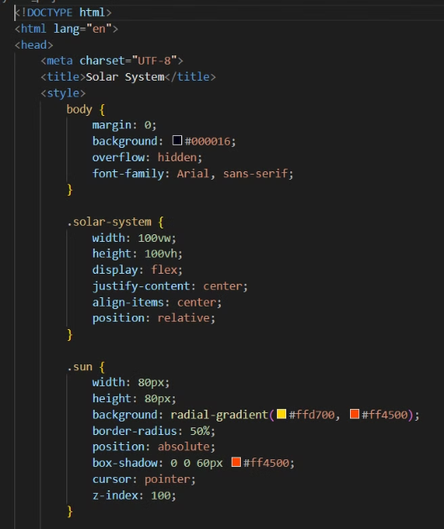
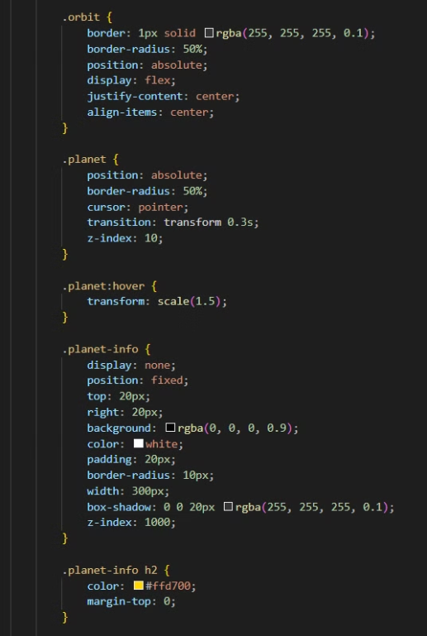
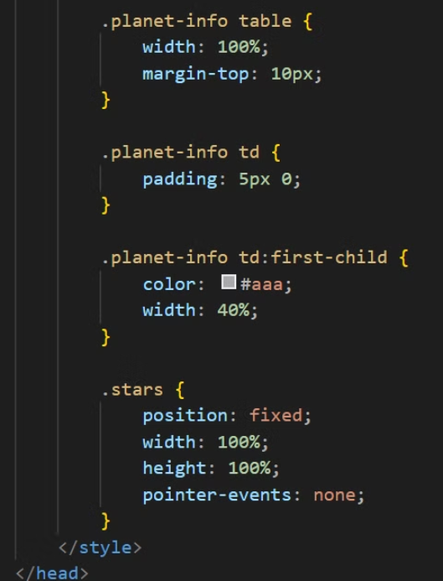
Simulation Code

Slide 10



Calculating Gravitational Forces
Newton's Law
1
Use Newton's law of universal gravitation to calculate the force between any two objects.
Orbital Speed
2
Using the formulas of gravitational force and centripetal force, we can derive the orbital speed of the planet.
Rotational Period
3
Use the calculated force to update the velocity and position of the celestial bodies over time.

Slide 11
Learnings from this project
The Solar System Simulation project helps in understanding of physics, programming, and computational modeling, offering practical experience in addressing complex real-world challenges. It also provides an opportunity to explore the capabilities of C in handling the logical aspects of the simulation at the backend.

Slide 12
Conclusion and Future Considerations
Project Summary
1
We have successfully built a C-based solar system simulation.
Future Directions
2
Explore incorporating more complex celestial objects, like comets or asteroids.
Further Enhancements
3
Add interactive elements, user input, or network capabilities , graphical and texture of the planets.

Slide 13

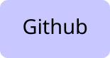
THANK YOU !!!
To explore more in this project, you can check our Github repository.

